Slide 1

Exploring Patterns: An EDA of Motor Vehicle Collision Crash Data
NYC (2018-2022)
DAB-103
Analytic Tools and Decision Making

Slide 2
Contexts
Team Name
Background/Motivation
Problem Statement
Project Proposal
Data Source Description
Attribute Description
Analysis Questions
Phase II – Planning
References

Slide 3
Team – 002
Jaya Rudra
Harpreet Kaur
Shubham Kharbanda
Sahith Valluripally
Priteshkumar Rana

Slide 4
Background/Motivation:
Automobile accidents pose a serious threat to public health all over the world. Accidents involving motor vehicles can be attributed to a wide range of causes, such as human error, mechanical failure, poor infrastructure, and natural disasters. In 2016, road traffic injuries were responsible for an estimated 1.35 million deaths globally, as reported by the World Health Organization (WHO). In other words, on average, one person is killed every 26 seconds.
Accident data analysis provides valuable information to law enforcement organizations, allowing them to better allocate resources and create more effective traffic enforcement and education initiatives. Additionally, insurance firms can more accurately price policies for motorists by studying data on auto accidents.

Slide 5
Problem Statement
Injuries, fatalities, and economic losses due to road traffic accidents continue to be a global public health problem despite efforts to reduce them. New obstacles occur as advances in transportation infrastructure, vehicle engineering, and population dynamics provide fresh challenges.
Vehicle accidents can be caused by a wide variety of variables, and in order to reduce their occurrence, it is essential to analyze these incidents.

Slide 6
Project Proposal
By combining data visualization with basic statistical analysis, our team will create a foundational model that can shed light on the problem, guide efforts to reduce the number of accidents, and even be used to help prepare machine learning algorithms.
Using an Exploratory Data Analysis, we are trying to identify the key factors, timings, locations, vehicle types influencing the collisions and crashes.

Slide 7
Data Source Description
The Motor Vehicle Collisions data contains the details of the crash event split by 5 boroughs of NYC. In the event of crash, the police department records the information by filling out a police report (MV104-AN) in the cases where someone is killed, injured or the damage is more than $1000 worth.
We have chosen a five-year window (2018-2022) to study the components, capturing the most recent trends, and leaving out the data for 2023 as it is an ongoing year and therefore, we don’t have the complete data.
The final data has 770,275 rows and 29 columns.

Slide 8
Attribute Description:
Feature name | Datatype | Description
Crash Date | Categorical | Date
Crash Time | Categorical | Time
Borough | Categorical | Town or district that is an administrative unit.
Zip Code | Categorical | Postal code
Latitude | Numeric | Geographic Co-ordinate
Longitude | Numeric | Geographic Co-ordinate
Location | Categorical | Contains both latitude and Longitude
On Street Name | Categorical
Cross Street Name | Categorical | a street intersecting a main thoroughfare especially at right angles and continuous on both sides of it.
Off Street Name | Categorical
Number Of Persons Injured | Numeric | Number of injuries happened during collision
Number Of Persons Killed | Numeric | Number of deaths happened during collision
Number Of Pedestrians Injured | Numeric | Number of injuries happened to people walking during collision

Slide 9
Number Of Pedestrians Killed | Numeric | Number of deaths happened to people walking during collision
Number of Motorist Injured | Numeric | Number of injuries happened to people on vehicle during collision
Number of Motorist killed | Numeric | Number of deaths happened to people on vehicle during collision
Contributing Factor Vehicle -1 | Categorical | Reason for accident
Contributing Factor Vehicle -2 | Categorical | Reason for accident
Contributing Factor Vehicle -3 | Categorical | Reason for accident
Contributing Factor Vehicle -4 | Categorical | Reason for accident
Contributing Factor Vehicle -5 | Categorical | Reason for accident
Collision_ID | Categorical | Unique ID representing an accident
Vehicle Type Code -1 | Categorical | Type of vehicle
Vehicle Type Code -2 | Categorical | Type of vehicle
Vehicle Type Code -3 | Categorical | Type of vehicle
Vehicle Type Code -4 | Categorical | Type of vehicle
Vehicle Type Code -5 | Categorical | Type of vehicle

Slide 10
Phase II - Planning
While analyzing the number of crashes by borough (Refer Graph in the next slide), we can see almost 35% of values missing. To reduce the missing numbers, we are planning to use information from additional columns zip code, latitude, longitude and locations to get the exact location. In cases where the null values can’t be imputed using the above columns, and zero fatalities recorded, we plan to remove such rows as they don’t have much insight to offer.
In our preliminary analysis, we have taken a quick look of main features of data to identify incomplete records, outliers and data segments. In the upcoming submissions, we will try to analyze the contributing factors, their trends, relationships with each other and answer the analysis questions.

Slide 11
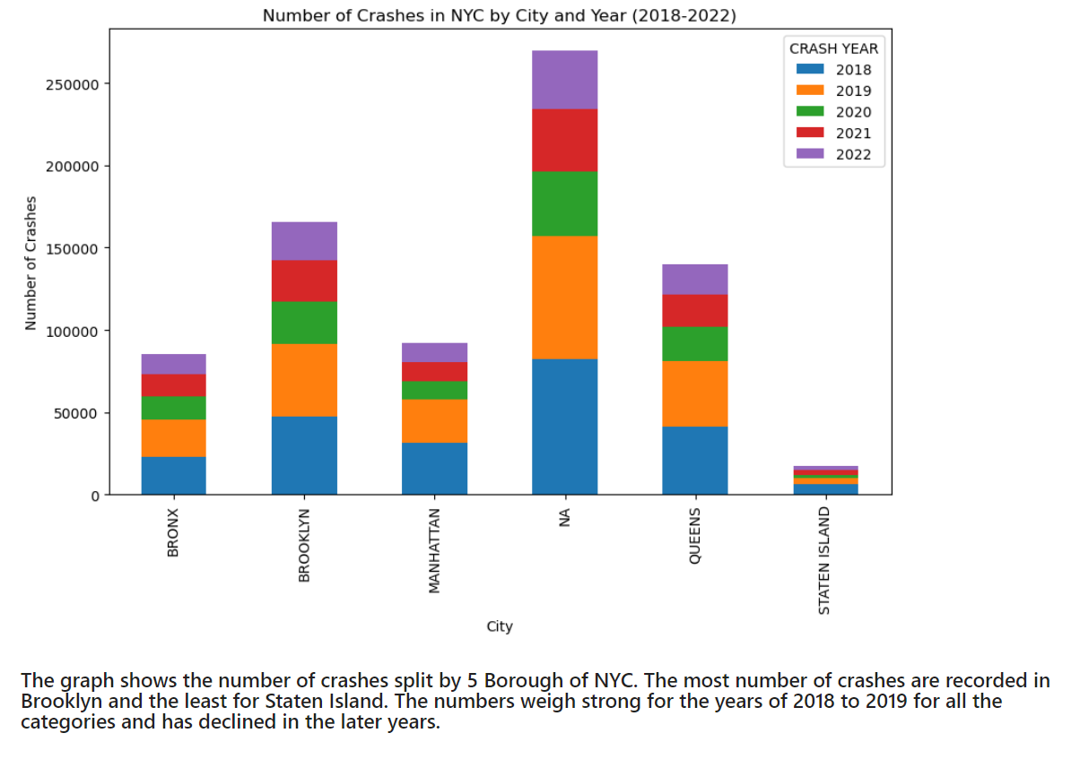

Slide 12
Analysis Questions:
During the past five years, at what time of day or day of the week were vehicle collisions most frequent in the NYC?
What were the major contributing factors to the location of the accidents, and which boroughs had the highest occurrence of collisions?
Which type of vehicles were involved in most accidents ?
What percentage of people by Borough were injured or killed because of these collisions?

Slide 13
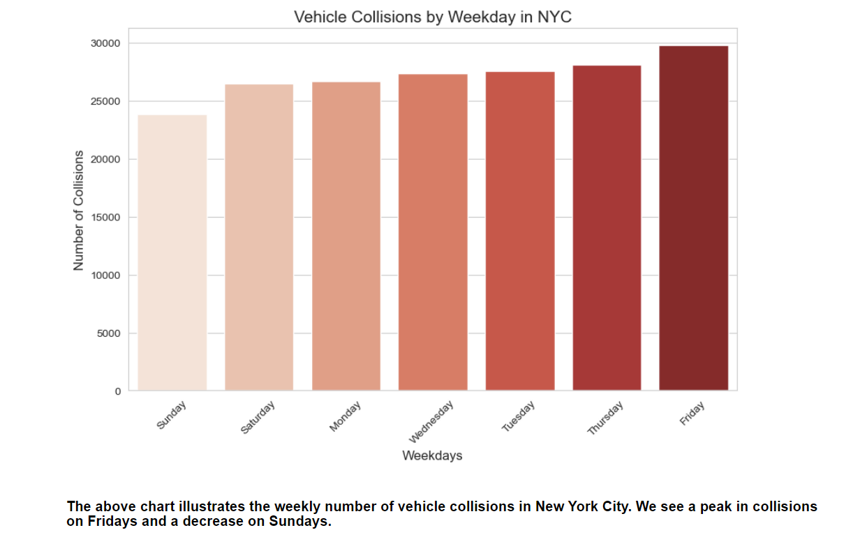
During the past five years, at what time of day or day of the week were vehicle collisions most frequent in the NYC?

Slide 14
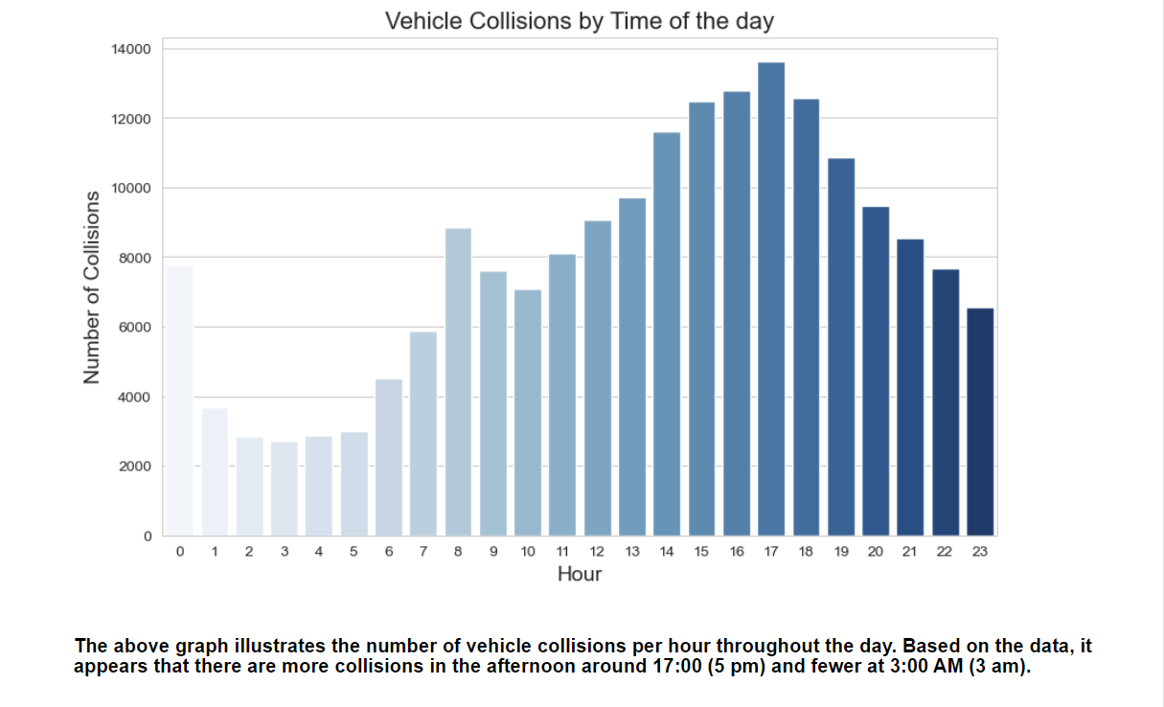

Slide 15
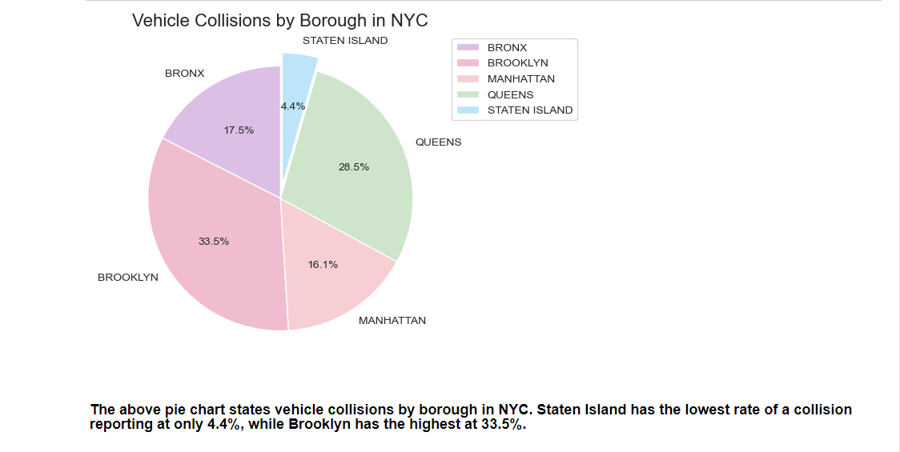
What were the major contributing factors to the location of the accidents, and which boroughs had the highest occurrence of collisions?

Slide 16
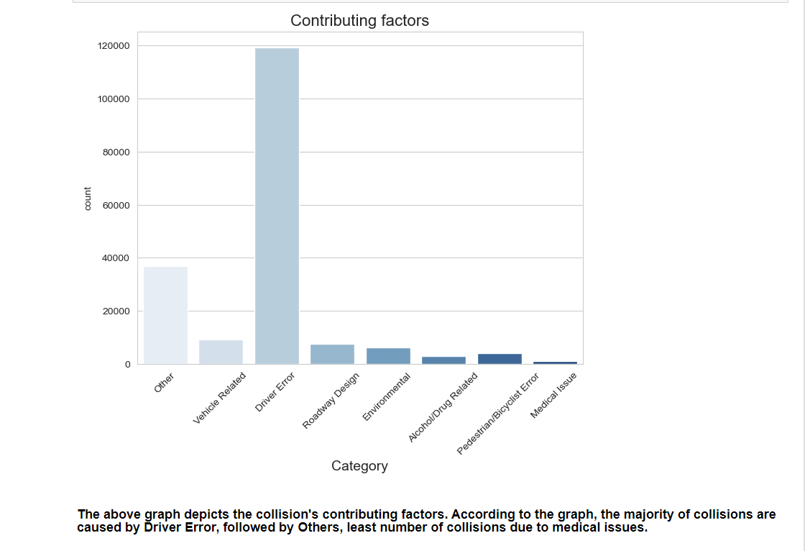

Slide 17
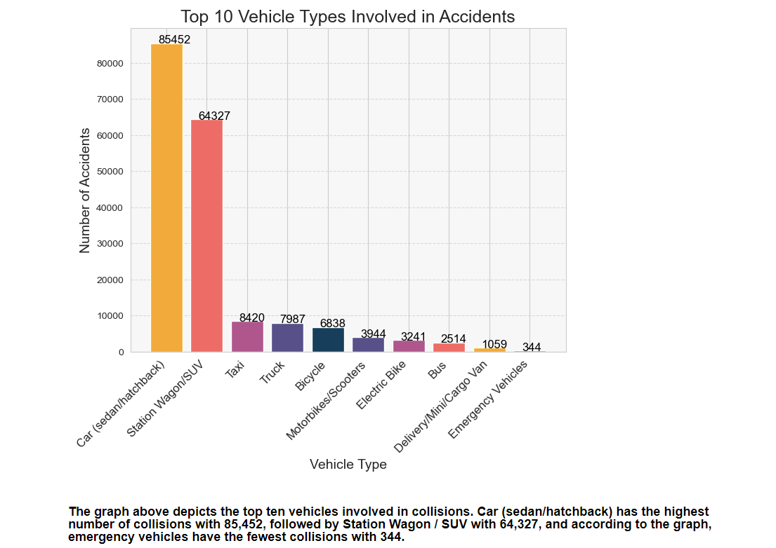
Which type of vehicles were involved in most accidents ?

Slide 18
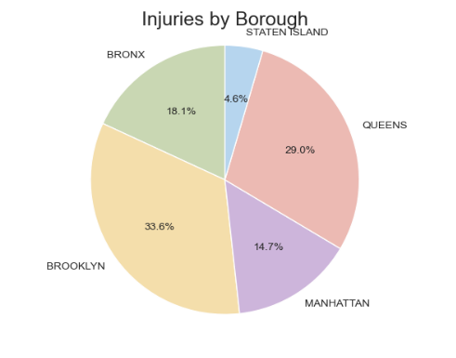
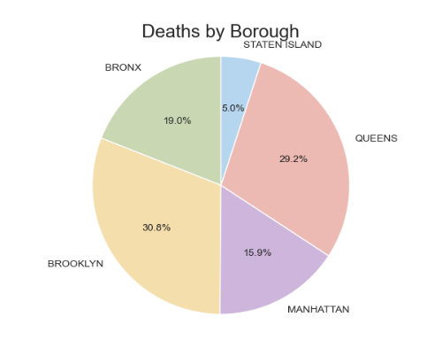
What percentage of people by Borough were injured or killed because of these collisions?
The pie chart above depicts the injuries sustained during the collision by the borough. According to the chart, Brooklyn has the highest number of injuries (33.6%) and Staten Island has the lowest (4.6%).
The pie chart above depicts the borough's recorded collision deaths. According to the chart, Brooklyn has the most deaths (30.8%), while Staten Island has the fewest (5.0%).

Slide 19
Conclusion
Accident rates in NYC remain relatively steady throughout the weekdays but experience a notable increase on Fridays before declining again on Sundays. The most collisions in NYC happen at 5:00 PM, while the least happen at 3:00 AM. The collision rates start to rise gradually around 6:00 AM and peak at 8:00 AM during the morning rush hour. The highest number of collisions is observed during the late afternoon, and the rates gradually decrease as the day progresses towards the evening.
Driver error is one of the major factors that contributes to the location of accidents, and our observations showed that the highest number of collisions occurred in Brooklyn.
Most vehicles involved in collisions are cars, specifically sedans and hatchbacks
The highest number of injuries (33.6%) occurred in Brooklyn, followed by Queens (29%) and Bronx (18.1%). This suggests that more focus should be placed on improving road safety measures in these areas.
Brooklyn also had the highest number of deaths (30.8%) because of motor vehicle collisions. Staten Island had the lowest number of deaths (5.0%)

Slide 20
Recommendations
Improve road safety measures in Brooklyn, Queens, and Bronx to reduce the number of injuries and deaths caused by motor vehicle collisions.
Drivers using cars like sedans/hatchbacks and SUVs should always be aware of blind spots.
Increase law enforcement presence by allocating additional police resources during peak accident times to deter reckless driving, enforce traffic laws, and ensure road safety.
Collaborate with employers to promote safe commuting practices among employees, such as encouraging flexible work schedules or encouraging ride-sharing initiatives to reduce the number of vehicles on the road during peak accident times.

Slide 21
References
[1] Dataset
https://catalog.data.gov/dataset/motor-vehicle-collisions-crashes
[2] Github
https://github.com/kharbanda95/EDA-MotorVehicleCollisionCrash

Slide 22
THANK-YOU

